Slide 1


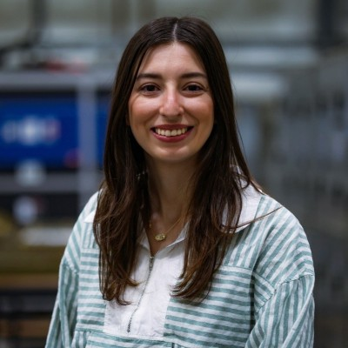
IEEE WILKES UNIVERSITY STUDENT BRANCH
GUEST SPEAKER ANNOUNCEMENT
DoD SMART
Scholarship Program
Science, Mathematics, and Research for Transformation
A scholarship-for-service program funded by the U.S. Department of Defense.
Dr. Kaitlyn Sitch
Electrical Research Engineer
NSWC Philadelphia
WILKES EE ALUMNA • FORMER SMART SCHOLAR
ABOUT DR. SITCH
ABOUT SMART
B.S. Electrical Engineering, Wilkes University, 2018
Ph.D. Electrical Engineering, Temple University, 2023
Dissertation: Efficient, Flexible, and Resilient Control for Optimal Operation of Hybrid-Electric Shipboard Microgrids
The Science, Mathematics, and Research for Transformation (SMART) Scholarship-for-Service Program is a DoD STEM initiative that combines education and workforce development for bachelor’s, master’s, and Ph.D. students in critical STEM fields.
Learn how a SMART Scholar can build technical experience while supporting the national security mission of the Department of Defense.
WHO: All Engineering, Mathematics, Computer Science, and Science Majors.
JOIN US
STARK LEARNING CENTER
Tuesday, September 29, 2026
Room 263
11:00 AM – 12:00 PM
IEEE Wilkes University Student Branch

